Slide 1


UFO Sightings
Team Tenacious:
Abi Chambers
Alejandro Perez
Carlos De La Rosa
Ann Ly

Slide 2

INTRODUCTION:
UFO Sightings in the United States
The first UFO sighting were reported as early as in the 1940’s, since then, with the help of the technologies, the increase in UFO sightings reported from all over the world has been growing exponentially. Today, we will only focus on the number of UFO sightings reported in the United States.

Slide 3
Color Palette

Slide 4
DATA INFORMATION

Slide 5
DATA INFORMATION
https://www.kaggle.com/datasets/camnugent/ufo-sightings-around-the-world
We used datasets provided from Kaggle.
We took an more than 80,000 UFO sightings reported from all over the world and narrowed it down to just sightings reported in the United States since the 1940s.
We utilized Jupyter Notebook to create visualizations, data cleaning, data binning as well as a UFO sighting map for the United State.

Slide 6
INSPIRATION
The most popular codes on Kaggle used the UFO sighting data in correspondence with meteorite landings and releases of popular movies. Most EDA’s closely resemble the type of analysis that we have done (locations, trends across year, types of UFO shapes).

Slide 7
RESEARCH QUESTIONS
Are there trends in the locations of sightings?
If so, do those trends extend to UFO shapes sighted, or length of the encounter?
Are there any changes in sighting frequency or locations over time?
Is there any significant relationship between sightings and particular times or?

Slide 8
Visualizations

Slide 9
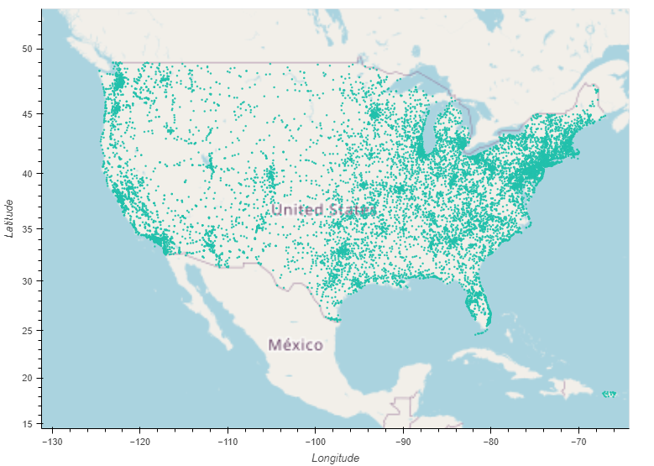
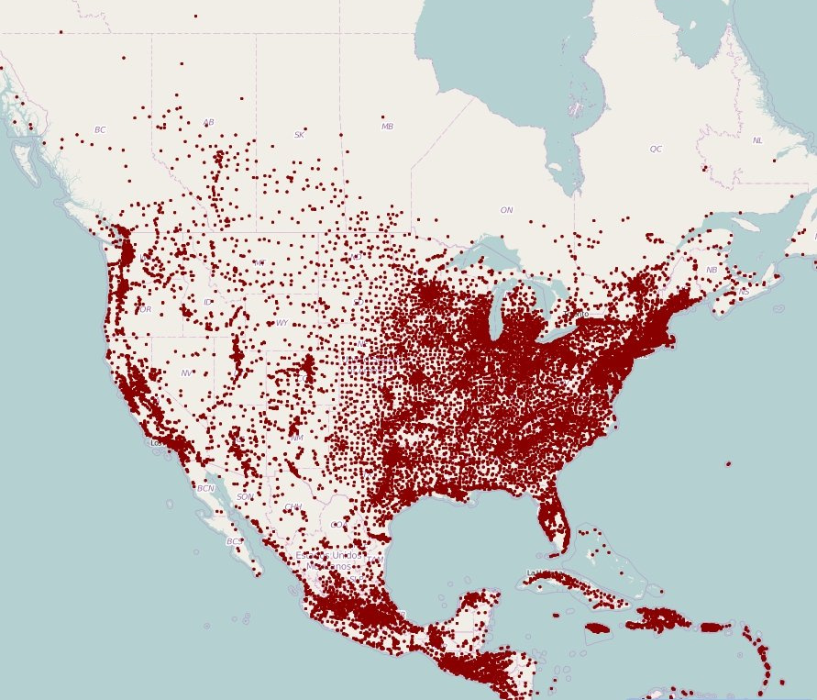
US Encounters: using coordinates of encounters
- cleaned data to look at only US coordinates
- at first glance, it looks like a typical US map showing population density
https://www.visualcapitalist.com/mapping-population-density-dot-town/

Slide 10
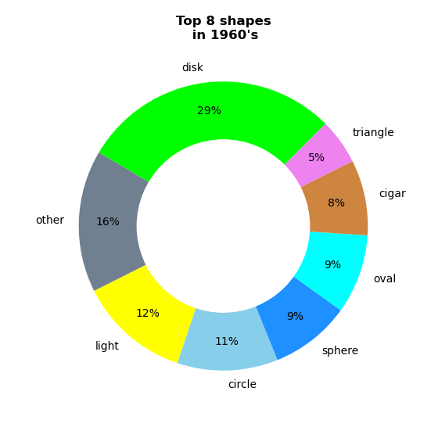
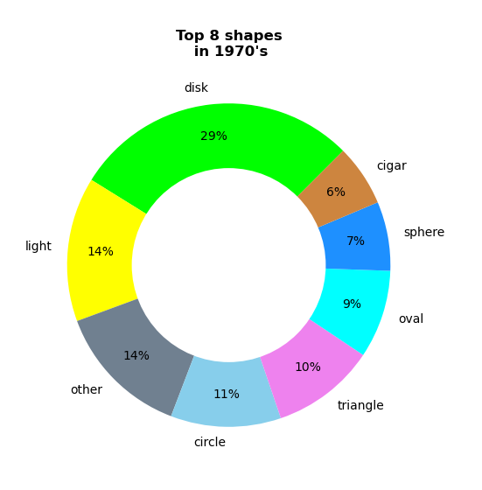
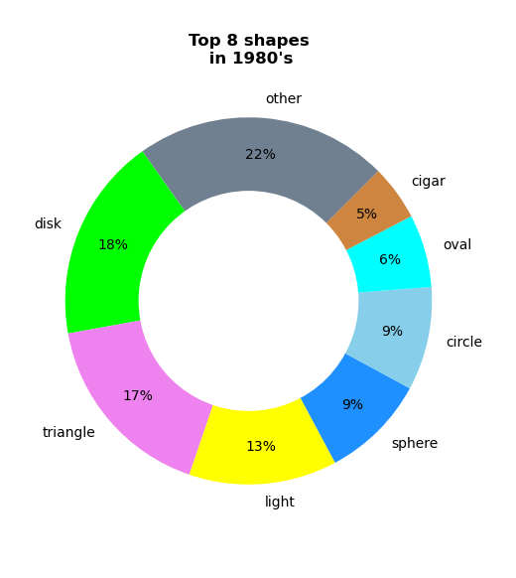
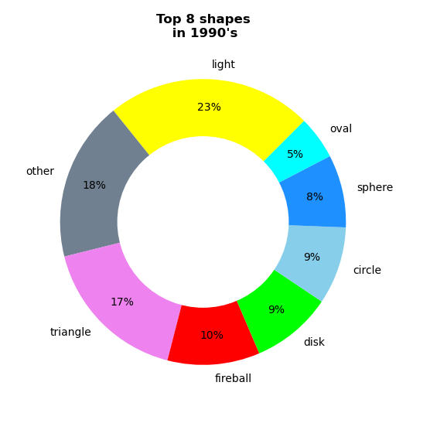
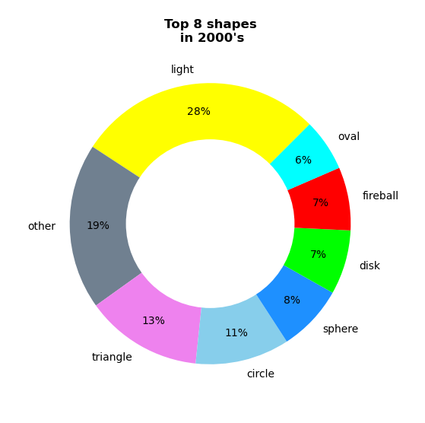
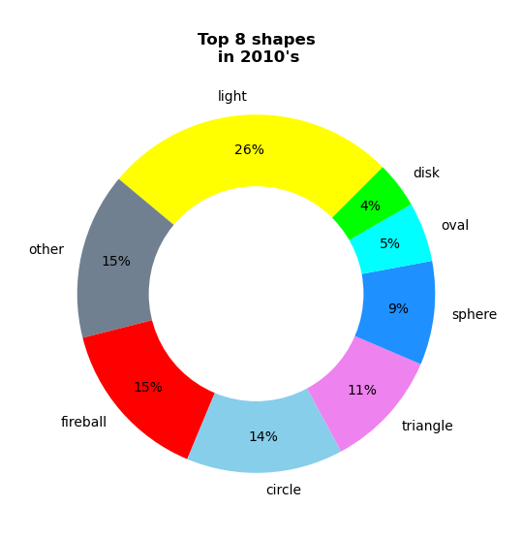
US Encounters: Analysis of the trend of UFO shapes
- used our data to look at the UFO shapes and binning into decades
- saw trends in popularity as 6 shapes were the most popular in 6 decades

Slide 11
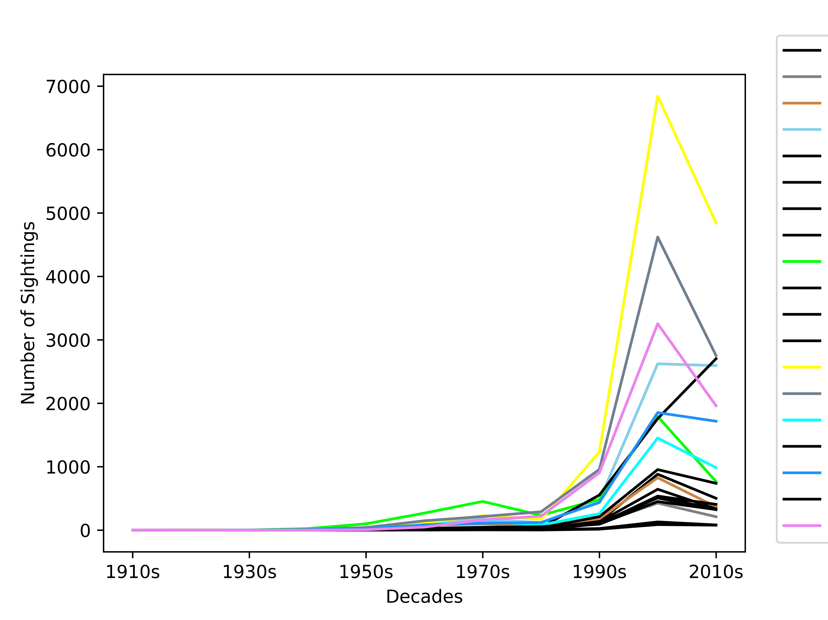
US Encounters: Analysis of the trend of UFO shapes
- used our data to look at the UFO shapes and binning into decades
- saw trends in popularity as 6 shapes were the most popular in 6 decades

Slide 12
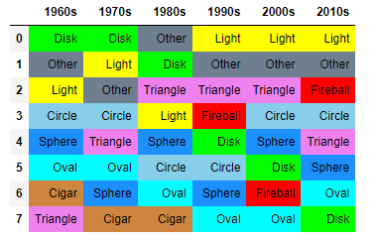
US Encounters: Analysis of the trend of UFO shapes
- used our data to look at the UFO shapes and binning into decades
- saw trends in popularity as 6 shapes were the most popular in 6 decades

Slide 13
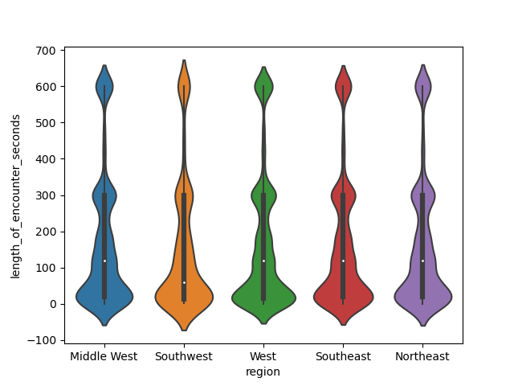

Slide 14
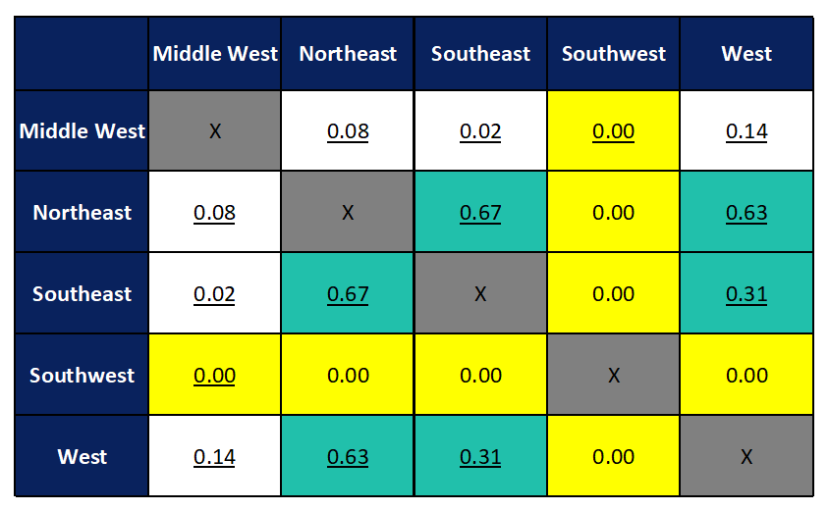
T-testing: using time duration of observation
- We looked at the significant difference between each region with respect to the average length of encounter
- Null Hypothesis: the difference in means for each pair of regions is zero (“the means are the same”)
T-test p-values
- We can reject the null hypothesis of “no difference in mean” and say that the true difference in means is not equal to zero for the pairs highlighted in yellow.
- ie, SW’s average of 154.83 seconds is different than the means in other regions
- Note that the p-values between W, NE, and SE (green) are higher and we can say that the true difference in means IS equal to zero
Means: MW: 173.89 seconds
W: 170.38 seconds
NE: 169.19 seconds
SE: 168.05 seconds
SW: 154.83 seconds

Slide 15
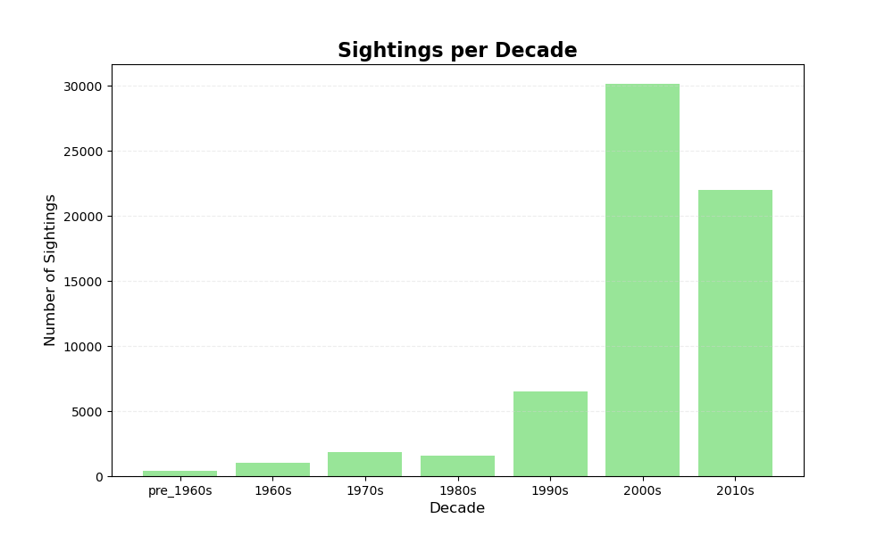
Sightings per Decade

Slide 16
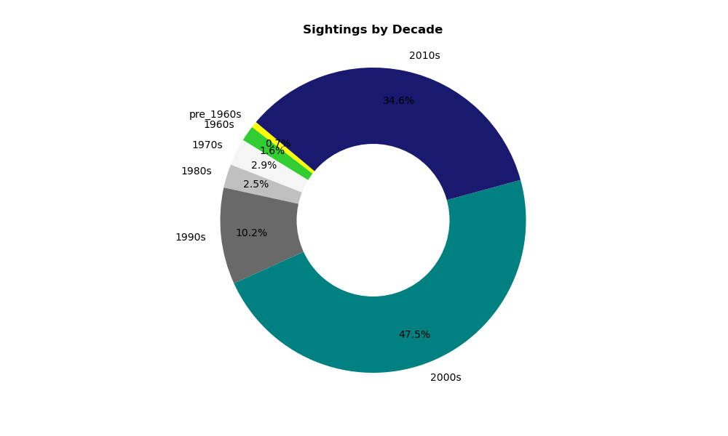

Slide 17
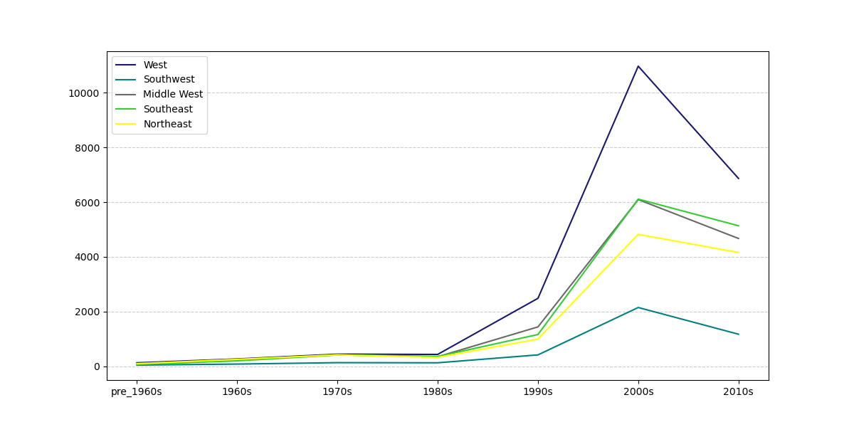
UFOs Sightings Trend Over the Decades

Slide 18
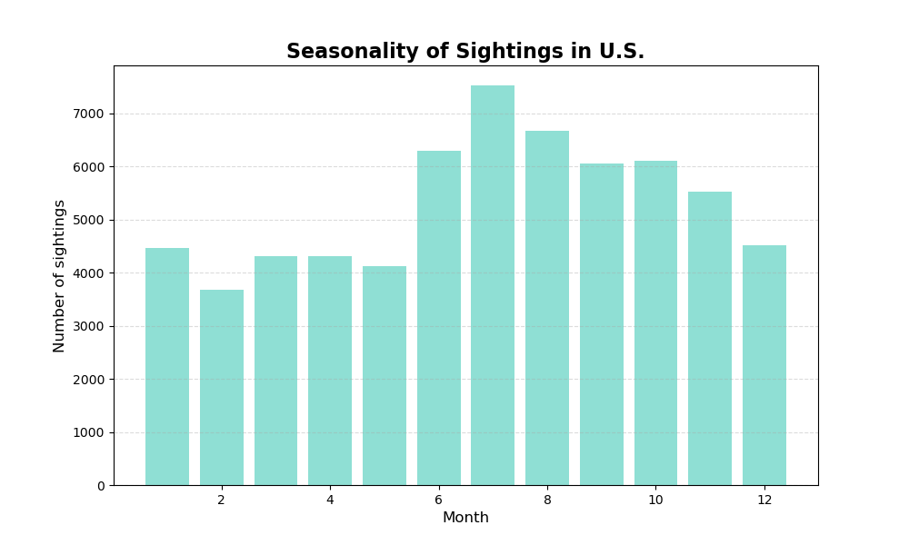

Slide 19

Relationships between sightings and particular times and dates ?
Seasonality of when sightings were most reported
Best months to witness a UFO sighting
Summer is the best time of the year

Slide 20
NUFORC data to determine which month people are most likely to see a UFO overhead. Overall, July topped the list with the most average monthly reports, followed by August, September, October, November
and June, in order.
Adams, R. D. (2022, July 27). July is top month for UFO sightings. here’s how likely you are to see one in Texas. Beaumont Enterprise. https://www.beaumontenterprise.com/news/article/UFO-sightings-by-state-best-places-to-see-UFO-17330047.php

Slide 21
IS THERE ANY CORRELATION BETWEEN LONGITUDE/LATITUDE VS. THE NUMBER OF SIGHTINGS ?

Slide 22
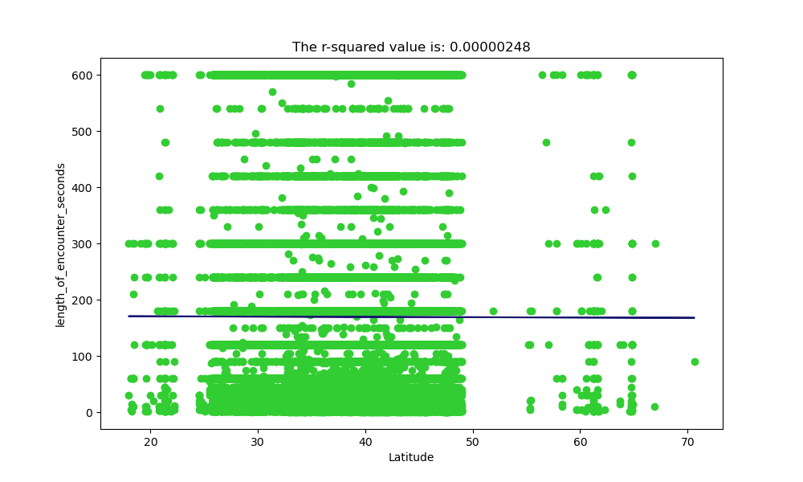
Regression
This is a scatter plot between length of encounters vs. the Latitude. The r2 value turned out to be .00000248 which means there is zero (0) correlation between the latitude and the encounter time.

Slide 23
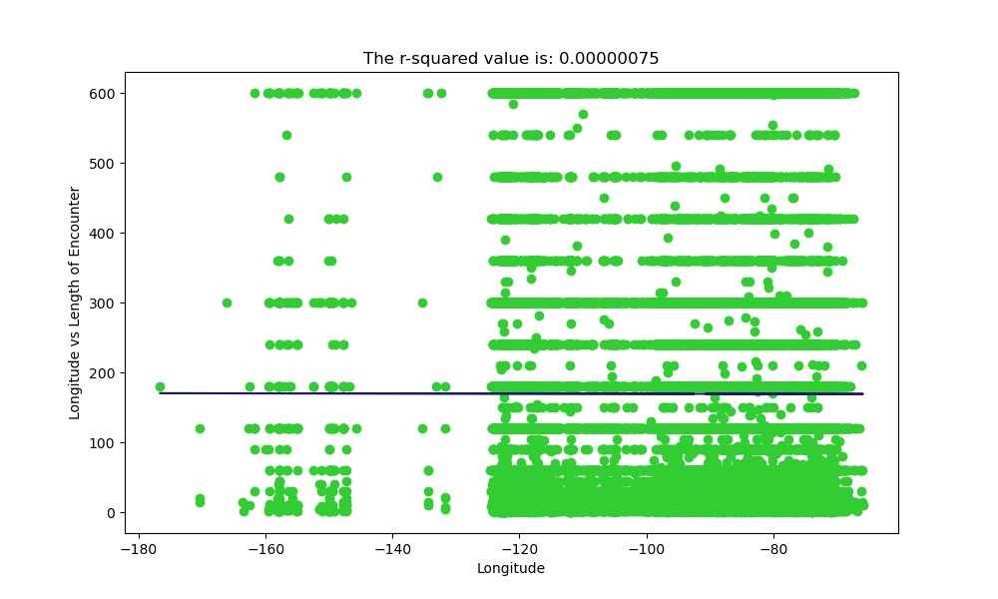
Regression (continued….)
This is a scatter plot between length of encounters vs. the Longitude. The r2 value turned out to be .00000075 which means there is zero (0) correlation between the longitude and the encounter time.

Slide 24
Interesting History About UFO Sightings

Slide 25


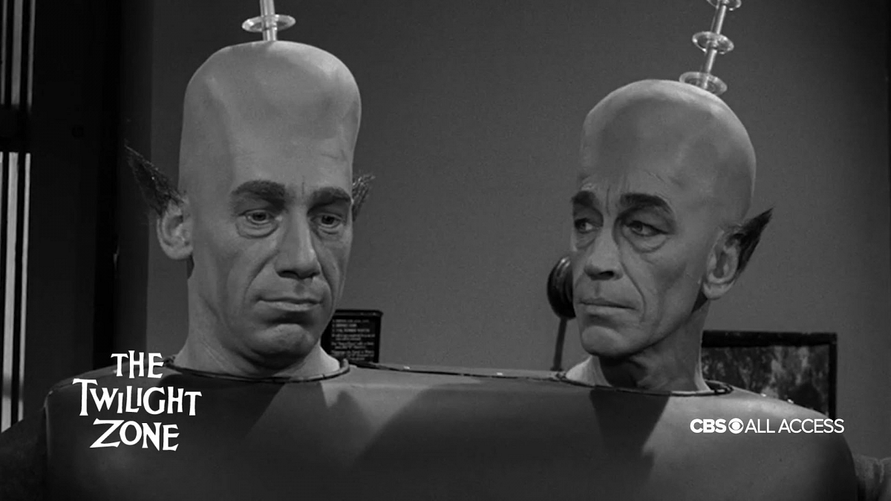
Area 51 is located in the southern portion of Nevada, 83 miles north-northwest of Las Vegas. It is a top secret military site where planes were constructed and tested. UFO sighting reported near the site goes as far back in the 1950s and still continue on till today. There are a lot of discussion regarding the UFO sightings near area 51, thinking those sightings might just be due to the testing of new spy aircrafts. Movies that inspired from Area 51 included “Independence Day” and “Paul”, also in episodes of the “Twighlight Zone” and the “X-Files,” as well as in “Scooby-Doo and the Alien Invaders.” (Source: “Everything to Know About Area 51's Mysterious History | Time”)

Slide 26
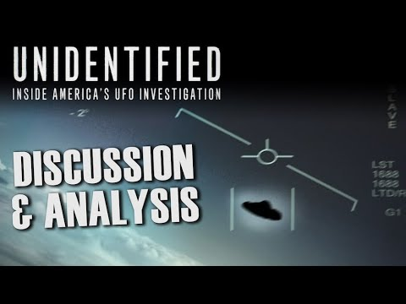
Project Blue Book – In 1947, Kenneth Arnold reported seeing 9 objects moving at high speeds through the skies over Washington’s Mount Rainier which lead to the government to begin an investigation into the sightings called “Operation Sign”, in 1948 and then later changed it to Project Blue Book in 1952. This is the longest running of the US’s government’s official investigating into UFO sightings. More than 12,000 sightings were investigated from 1952 to 1969 where they ended the project. 90% of the sighting were classified as “identified”, and the other 10% were simply insufficient information to determine if the sightings were legit. (Project Blue Book (history.com)

Slide 27
Are they out there?

Slide 28
Thank You

